Slide 1
SMART AID FOR SPEECH AND HEARING IMPAIRED COMMUNITY USING CNN

Slide 2
CAPSTONE PROJECT(CSE 4099)
SUBMITTED TO :
Dr. MOHAN RAJ
PROF. TULASI PRASAD SARIKI
Dr. SIVAGAMI M
GUIDE :
Dr. B V A N S S PRABHAKAR RAO
SUBMITTED BY :
LAVANYA SHIVANI (15BCE1076)
MANISHA CHAUDHARY(15BCE1358)
AKASH (15BCE1369)

Slide 3
ABSTRACT
Deaf and dumb people uses gesture based communication to communicate with the world using hand gestures. Sign language is the only single way of communication for deaf and dumb people. But common people face difficulty in understanding the gesture language therefore often these physically challenged people has too keep the translator with them to communicate with the world. The progression in implanted framework can give a space to plan and build up an interpreter framework to change over the communication via gestures into discourse. These days implanted framework has turned into a critical pattern in all applications. Our prototype can be used for the welfare of the society . Firstly for the travelling purpose , dumb people face problems while expressing . So they can use our translator which gets converted into text thus helping the pedestrians or the common people. This can be used the either way too that is conversation amongst different groups of deaf and dumb. Different group refers to deaf and dumb people knowing different sign languages as (ASL,ISL,BSL etc.). Secondly , this can be used for the shopping purpose when the mute people can’t reply to the owner or the deaf people can’t hear to the directions shown through audio. Also , for the meeting purposes where one of the co-worker wants to share his/her views with (HR) but can’t speak so here our prototype comes into the picture . Now let us take the situation where the HR who is dumb wants to convey some regards to the one who is deaf, to which he can use our prototype which could be helpful enough to make a successful meeting . So we would be using Convolution Neural Network (CNN) which would implement our prototype .Thus reducing the pre-processing and enhancing the overall recognition process. The work exhibited fundamentally lessens the correspondence gap amongst imbecilic and standard individuals and intends to encourage dumb individuals way of life.

Slide 4
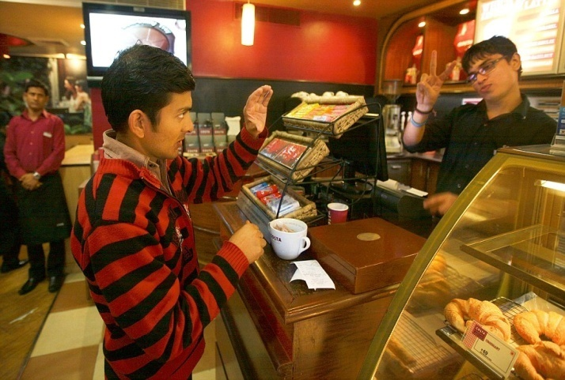
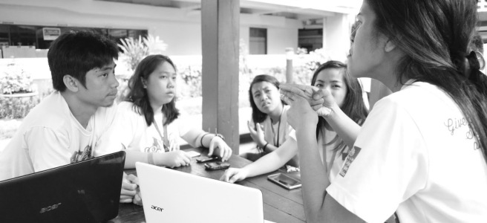
BACKGROUND
Gesture recognition and sign language recognition has been a well researched topic for American Sign Language(ASL), however few research works have been distributed with respect to Sign Language(ISL). One of the methodologies included key point discovery of Image utilizing SIFT and afterward coordinating the key point of another picture with the key points of standard pictures per letters in order in a database to arrange the new picture with the mark of one with the nearest coordinate . Another determined the Eigen vectors of covariance framework determined from the vector portrayal of picture and utilized Euclidean separation of new picture Eigen vector with those in preparing informational collection to characterize new picture . However , rather than utilizing top of the line innovation like gloves , we plan to take care of this issue utilizing CNN.

Slide 5
PROJECT DESCRIPTION
Creating communication through signing application for hard of hearing individuals can be essential, as they'll have the capacity to discuss effectively with even the individuals who don't get it communication through signing.
Our project aims for taking the essential steps in connecting the communication gap between ordinary individuals, hearing and speech impaired individuals utilizing sign language.
The principle focal point of this work is to make a vision based framework to recognize sign language gestures from the video groupings.
The explanation behind picking a framework is relates to the fact that it gives an easier and progressively natural method for correspondence between a human and a computer.
In this project, 46 diverse gestures have been considered. To prepare the model on the spatial features of the video sequences we have utilized CNN (Convolution Neural Network) model.

Slide 6
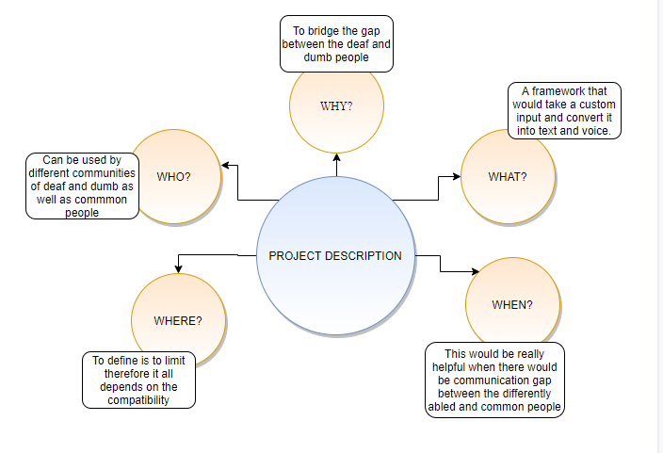

Slide 7
THREE APPROCAHES
USING SENSOR :
The sensor based system consists a combination of hardware and software modules.
Hardware segment will incorporate flex sensors on every finger.
Flex sensors takes input as different gestures through gloves, microcontroller is used to convert input analog signal to digital data and further processing can be done.
USING IMAGE PROCESSING :
Reading image from camera and applying pre-processing techniques like gamma correction, blurring. Hand Segmentation using background subtraction algorithm is done.
Hand detection using thres-holding and dilation.Finding contours of hand for getting shape of hand Finding contour area, convex hull, hull area, solidity .
Also we can find the angle between two fingers and aspect ratio of hand as well as finding the defects of hand using convex hull , and finally classifying using solidity, aspect ratio, convex defects and angle,
if image (sign) matches with the database image, then ON the led and speak the meaning of that sign

Slide 8
CNN (CONVOLUTION NEURAL NETWORKS)

Slide 9
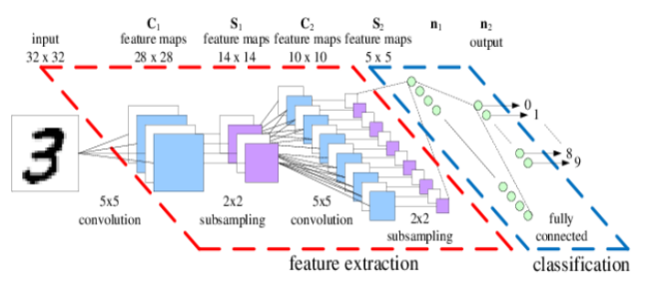

Slide 10
CONVOLUTION : Convolution layer are the set of filters which are applied to an given input image.
SUBSAMPLING : Its function is to progressively reduce the spatial size of the representation to reduce the amount of parameters and computation in the network.

Slide 11
ACTIVATION : The process of building a neural network, one of the choices you get to make is what activation function to use in the hidden layer as well as at the output layer of the network.
FULLY CONNECTED : The output layer in a CNN is a fully connected layer, where the input from the other layers is flattened and sent so as the transform the output into the number of classes as desired by the network

Slide 12
TECHNICAL SPECIFICATIONS

Slide 13
KERAS
Keras is an open-source neural-network library written in Python.
It is capable of running on top of TensorFlow, Microsoft Cognitive Toolkit, Theano, or PlaidML.
Designed to enable fast experimentation with deep neural networks, it focuses on being user-friendly, modular, and extensible.

Slide 14
ANACONDA AND JUPYTER
Anaconda is package manager. Jupyter is a presentation layer The Jupyter Notebook allows us to create and share documents that contain live code, equations, visualizations and narrative text. Uses include data cleaning and transformation, numerical simulation, statistical modeling, data visualization, machine learning, and much more.
Anaconda tries to solve the dependency hell in python—where different projects have different dependency versions—so as to not make different project dependencies require different versions, which may interfere with each other.

Slide 15
PIP
It is a package management system used to install and manage software packages/libraries written in Python.
In particular pip has an feature to oversee full lists of packages and comparing form numbers, conceivable through a "requirement" file.
This allows the effective re-formation of a whole groups of packages in a different environment (for example another PC) or virtual environment.

Slide 16
RESULTS

Slide 17
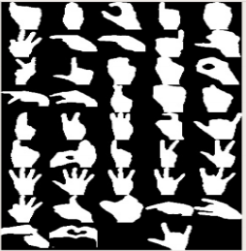
ALL GESTURES

Slide 18
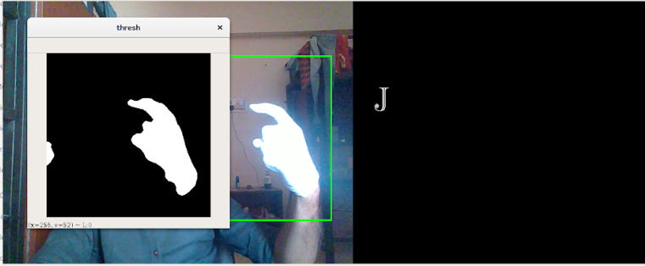
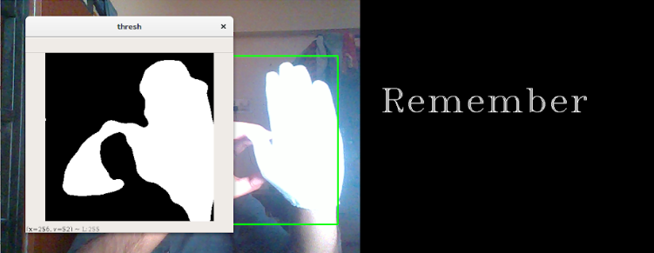
TEXT MODE

Slide 19
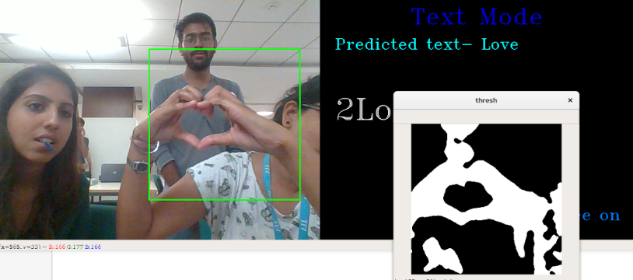
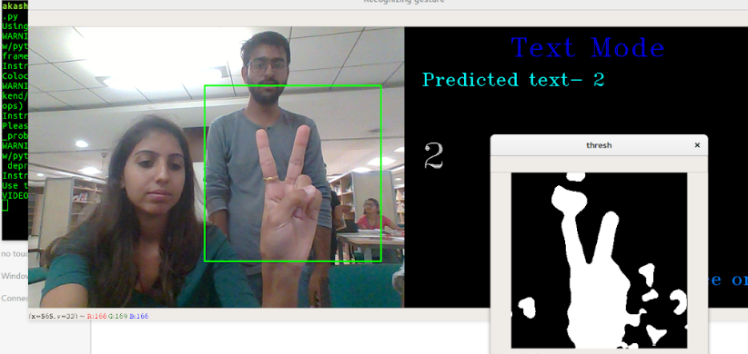
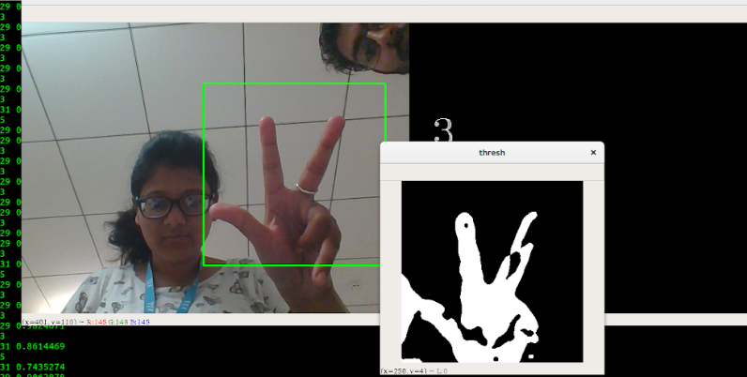

Slide 20
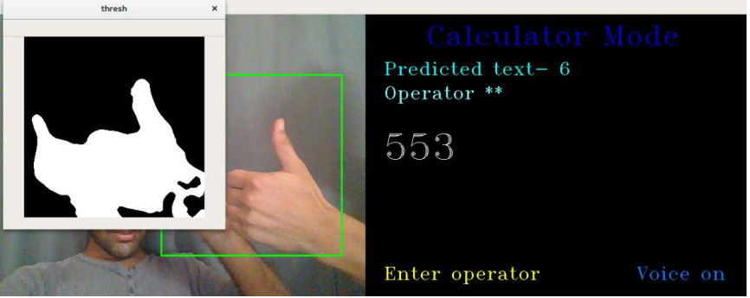
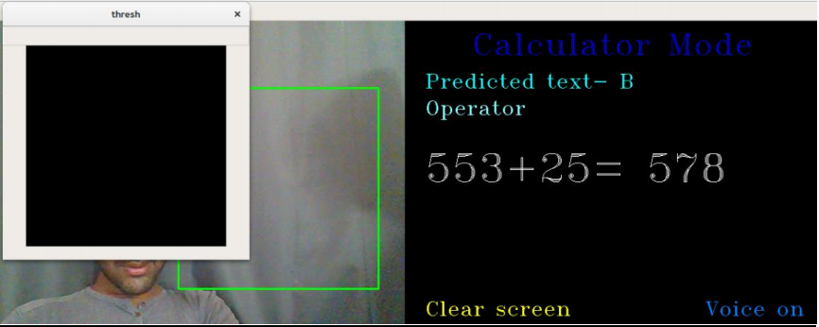
CALCULATOR MODE

Slide 21
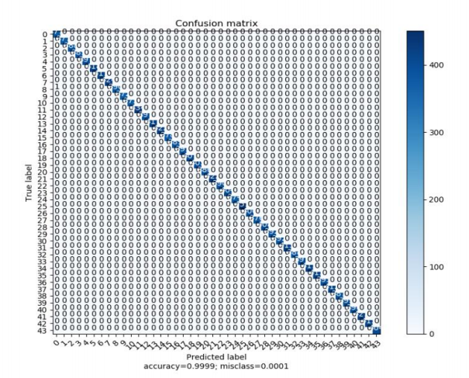
CONFUSION MATRIX
Confusion matrix is also termed as an error matrix which is a particular table layout that creates visualization of the performance of an algorithm

Slide 22
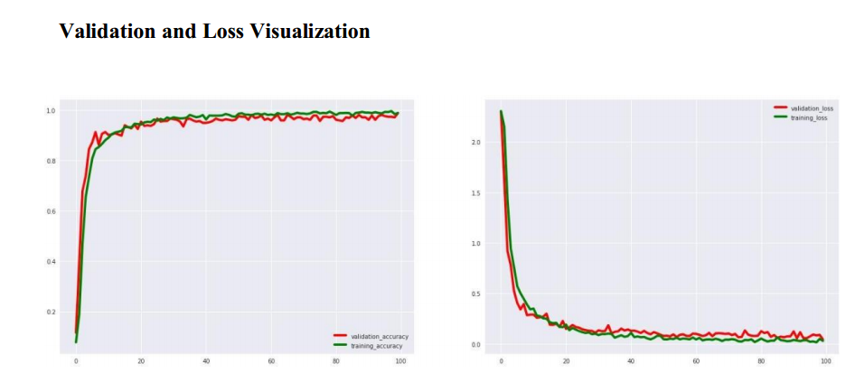
VALIDATION AND LOSS VISUALIZATION

Slide 23
CONSTRAINTS
Time : The time taken for training the data is more in the local machine, so this makes us work on the cloud as it is deployed easily.
Cost : We cannot use sensors as it would be costly, so we end up using CNN model which is cost effective.
Data Quality : Inconsistent duplicate corrupt data needs to be handled which should be done carefully.

Slide 24
CONCLUSION

Slide 25
Our project is basically sign language recognition which would be quite beneficial for the deaf and dumb as well as common people. So, the methodology adopted in our project is to develop a framework that would carry on the entire process.
The model used is CNN(Convolution Neural Networks).So initially we made the dataset by capturing images which comprises of alphabets and digits .
The alphabets would be used for the formation of text and the digits would be used for the mathematical operations. From the entire framework we can conclude that the above framework is quite reliable, and the model gives the best results with accuracy 99.99% which is quite reliable and is cost effective as well.
So we can use this model for the better livelihood of deaf and dumb people who can reciprocate as well to the common people.

Slide 26
FUTURE WORK
Our prototype can also be android based which would be quite portable .
We can also use different sign languages (ASL, ISL , BSL etc.) for establishing an effective communication.

Slide 27
THANK YOU !!

